Slide 1
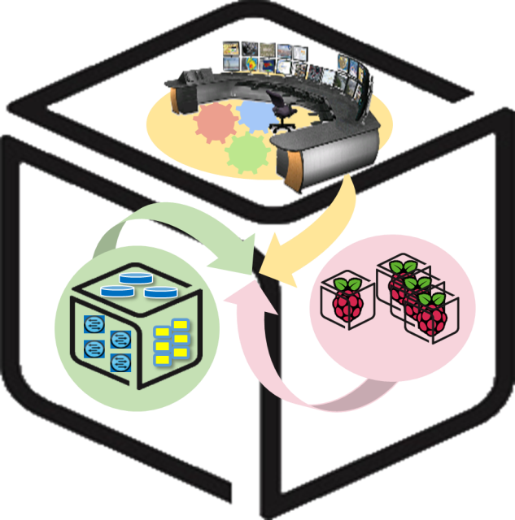
SmartX Labs for Computer Systems
InterConnect Lab
(2018, Spring)
NetCS Lab

Slide 2
History and Contributor of InterConnect Lab
(2018. 04. 30)
Version | Updated Date | Updated Contents | Contributor
v0.1 | 2017/05 | Merged with InterConnect & Tower Lab | Seungryong Kim
v0.2 | 2018/01 | InfluxDB 버전 업데이트 스크립트 변경 | Seunghyung Lee
v0.3 | 2018/04 | Tower Lab 부분 분리, 일부 설명 수정 | Moonjoong Kang

Slide 3
Goals
Understanding Concepts
Net-SNMP, Flume, Kafka, Hypriot OS
Connecting with each functions
With Raspberry Pi and NUC

Slide 4
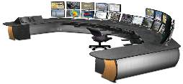

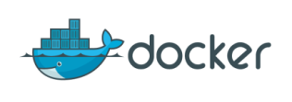







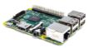

Concept: InterConnect Lab
You
Kafka broker cluster
Hypriot OS
Ubuntu Linux
Raspberry Pi
NUC
Notes:
IoT-FastData-Cloud에 기반한 Container 대응 SmartX-mini

Slide 5
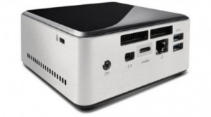





Cont’d
Timestamp, IP Address, Value1, Value2, …
Timestamp, IP Address, Value1, Value2, …
Timestamp, IP Address, Value1, Value2, …
…
Timestamp, IP Address, Value1
Timestamp, IP Address, Value1
….
Kafka Cluster
Topic 1 (Load Average)
……
Topic 2
(Memory Utilization)
Topic 3
(CPU Utilization)
Topic 4
(IO)

Slide 6

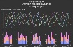






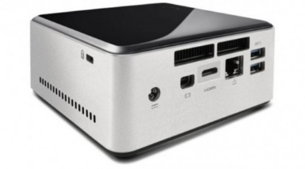


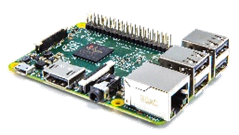



Relation of SmartX Lab
Control Tower (VM)
Orchestration
Center
(Container)
Provisioning
Center (Container)
Intelligence
Center (Container)
Visibility
Center
(Container)
Tower Lab
Base OS
Kafka broker cluster
Box Lab
VM
Tap1
br0
em1
InterConnect Lab
Hypriot OS

Slide 7
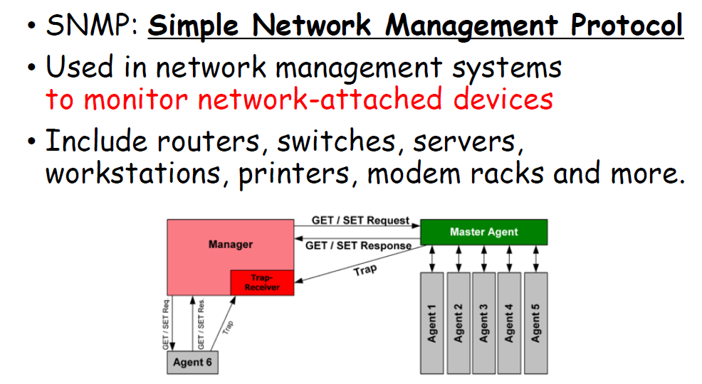
SNMP
Backgrounds

Slide 8

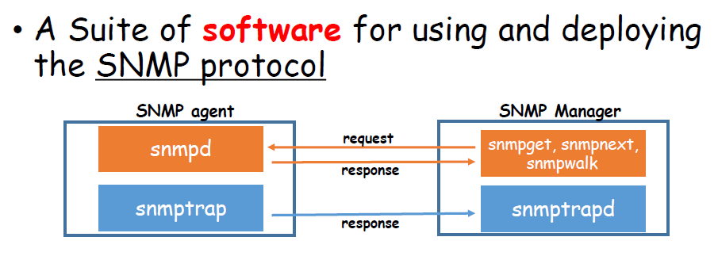
Net-SNMP
Backgrounds

Slide 9

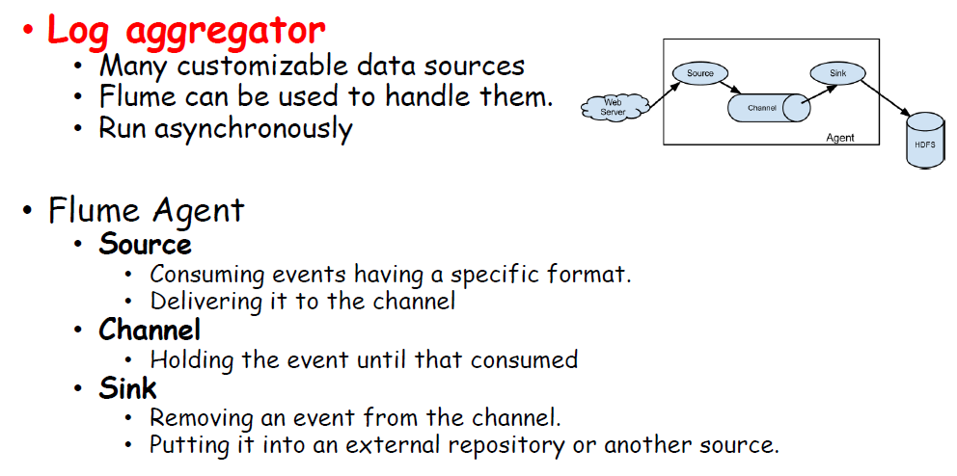
Flume
Backgrounds

Slide 10

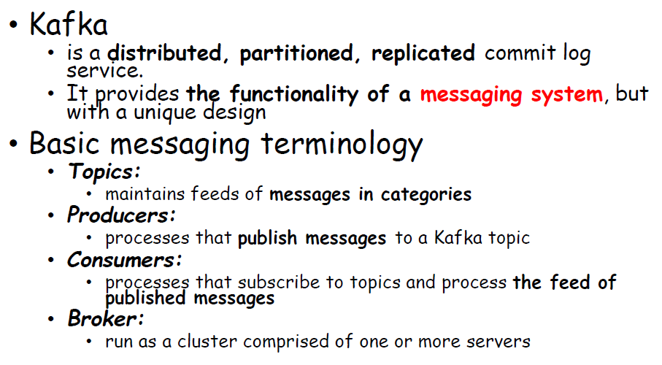
Kafka
Backgrounds

Slide 11
Backgrounds
Kafka: Architecture
Kafka Cluster
broker1
Producer
TCP Protocol
TCP Protocol
Consumer
Broker2
(Leader)
broker3
Zookeeper
Cluster
Notes:
http://blog.acronym.co.kr/483

Slide 12
Backgrounds
Cont’d
Zookeeper
Producers(Pi #1)
Node 0 (Master)
Broker 0
Producers(Pi #2)
Node 1 (Slave 1)
Broker 1
Consumers
(Spark Streaming)
. . . . . . . .
Node 2 (Slave 2)
Broker 2
Node 3 (Slave 3)
Broker 3
Producers(Pi #20)

Slide 13
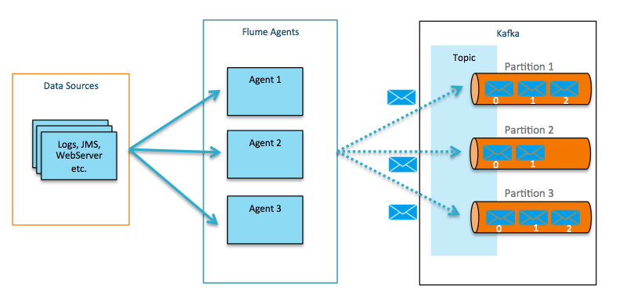
Backgrounds
Kafka: with Flume
Flafka : Apache Flume Meets Apache Kafka for Event Processing
Notes:
http://blog.cloudera.com/blog/2014/11/flafka-apache-flume-meets-apache-kafka-for-event-processing/

Slide 14
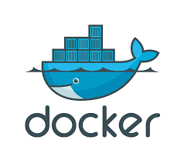
Backgrounds
Docker is an open platform for building, shipping and running distributed applications. It gives programmers, development teams and operations engineers the common toolbox they need to take advantage of the distributed and networked nature of modern applications.

Slide 15
Connecting Configuration on NUC

Slide 16
In this section
You
Kafka broker cluster
Kafka broker cluster
Hypriot OS
Ubuntu Linux
Raspberry Pi
NUC
Notes:
IoT-FastData-Cloud에 기반한 Container 대응 SmartX-mini

Slide 17

0. Install HypriotOS on Raspberry Pi
Before we start, your Raspberry Pi must be ready with proper OS.
In this lab, we will use “HypriotOS” Linux for it.
Eject a MicroSD card from your Raspberry Pi, and insert it into your SD card reader and attach the reader to your NUC.
Issue the commands below to get “flash” script for the OS setup.
$ sudo apt update && sudo apt install -y pv curl python-pip unzip hdparm
$ sudo pip install awscli
$ curl -O https://raw.githubusercontent.com/hypriot/flash/master/flash
$ chmod +x flash
$ sudo mv flash /usr/local/bin/flash
Issue “flash” command to see if it’s installed correctly.

Slide 18

0. Install HypriotOS on Raspberry Pi
Download & edit HypriotOS configuration file for your Raspberry Pi.
$ wget -O hypriot-init.yaml https://mirror.nm.gist.ac.kr/getHypriotConf
Let’s open the “hypriot.yaml” file and edit its network section.
The assigned IP address will be automatically applied, when you’re initially booting your Raspberry Pi.
$ sudo vi hypriot.yaml
…
# static IP configuration:
interface eth0
static ip_address=172.29.0.250/24 # Write your Raspberry Pi address
static routers=172.29.0.254
static domain_name_servers=8.8.8.8 8.8.4.4
…
15

Slide 19
0. Install HypriotOS on Raspberry Pi
Download & write Hypriot OS image to your MicroSD card.
$ flash -u hypriot-init.yaml -d /dev/sdb -f https://mirror.nm.gist.ac.kr/getHypriot
Be careful! Wrong –d option may lead to the loss of NUC’s OS!
NOTE: This may take some time, even after its gauge reached 100%.
And, that’s it! Now HypriotOS is flashed to your MicroSD card.
Insert the card back to your Raspberry Pi and boot it up.

Slide 20
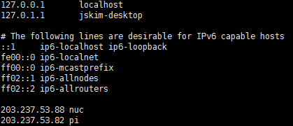
1. Edit /etc/hosts (for NUC)
Every machine which communicate with themselves must know their own address.
Edit /etc/hosts
$ sudo vi /etc/hosts
(For Example)
Add two lines which describe the IP address and hostname of devices

Slide 21
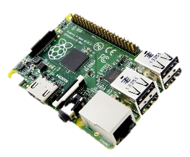
1. Edit /etc/hosts (for Pi)
Every machine which communicate with themselves must know their own address.
SSH into your Pi (ID: pirate, PW: hypriot)
$ ssh pirate@<Your Raspberry Pi IP address>
Edit /etc/hosts
$ sudo vi /etc/hosts
(For Example)
Add two lines which describe the IP address and hostname of devices

Slide 22
1. Edit /etc/hosts
After editing /etc/hosts, check the edit is done correctly
For NUC
$ ping <Your NUC hostname>
$ ping <Your Raspberry Pi hostname>
For Raspberry Pi
$ sudo ping <Your NUC hostname>
$ sudo ping <Your Raspberry Pi hostname>

Slide 23
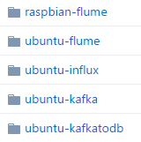
2. Download Source from Github
Download all files from Github
(http://github.com/SmartXBox/SmartX-mini)
$ git clone https://github.com/SmartXBox/SmartX-mini.git
Folder List
In this section, we use this

Slide 24
3. Allocate Broker IDs and Ports
We’ll use a one zookeeper, 3 brokers and one consumer containers which share host’s public IP address
Zookeeper container doesn’t have broker id.
Each Broker has a unique id and port to interact each other.
Consumer container just used to manage topic and check the data from brokers.
Container Name | IP address | Broker id | Listening port
zookeeper | Host’s public IP address | - | 2181
broker0 |  | 0 | 9090
broker1 |  | 1 | 9091
broker2 |  | 2 | 9092
consumer |  | - | -

Slide 25
4. Build Docker Image
Build Docker Image
$cd ~/SmartX-mini/ubuntu-kafka
Build Dockerfile ※ It takes long time.
$ docker build --tag ubuntu-kafka .
If you want to check Docker instruction words
$ docker --help
ex) docker ps : List containers
docker start : Start one or more stopped containers
docker rm : Remove one or more containers

Slide 26
5. Run Docker Container (recommend making new terminal window)
Run Docker Container
$ docker run -it --net=host --name [container name] ubuntu-kafka
We need to run 5 containers (zookeeper 1, broker 3, consumer 1)
Let’s assume the name of each containers,
zookeeper, broker0, broker1, broker2, consumer
Repeatedly type the above command with changing container name
If you want to look for more details about Docker command, see https://docs.docker.com/reference/commandline/

Slide 27
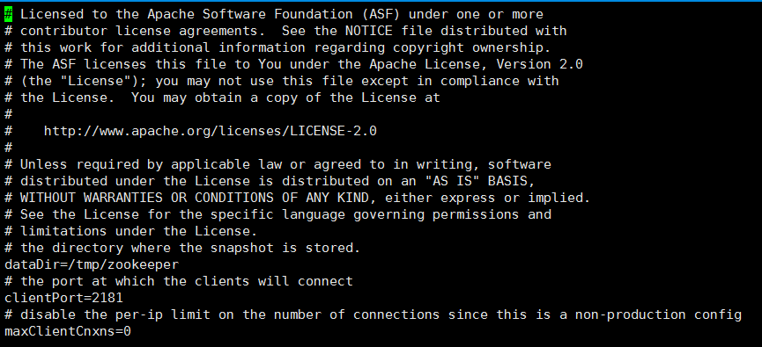
6-1. Configure Zookeeper properties
Actually we use default configurations
Open zookeeper properties file
$ vi config/zookeeper.properties
Check the client port

Slide 28
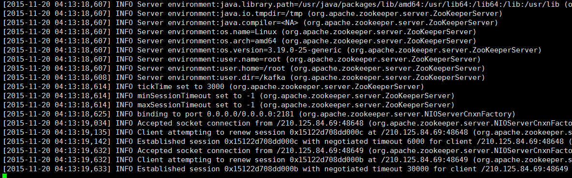
6-2. Launching Zookeeper
zookeeper must launch first
$ bin/zookeeper-server-start.sh config/zookeeper.properties
Leave Zookeeper running and open a new terminal for next tasks
Zookeeper address
Zookeeper address
Zookeeper address
Zookeeper address
Zookeeper address
Zookeeper address

Slide 29
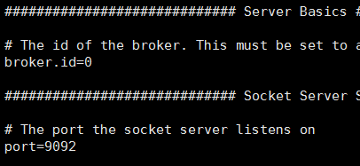
7-1. Configure Kafka properties
Create a Kafka container with the docker command before
docker run -it --net=host --name [container name] ubuntu-kafka
Open server properties file and change proper broker id and port (they must be unique to each other) (Only for broker0,1,2)
$ vi config/server.properties
Launch Kafka brokers (Only for broker0,1,2)
$ bin/kafka-server-start.sh config/server.properties
Repeat previous steps for broker0, broker1, broker2,consumer
Container Name | Broker id | Listening port
broker0 | 0 | 9090
broker1 | 1 | 9091
broker2 | 2 | 9092
consumer | - | -
broker id
port
Consumer container will not run any brokers

Slide 30
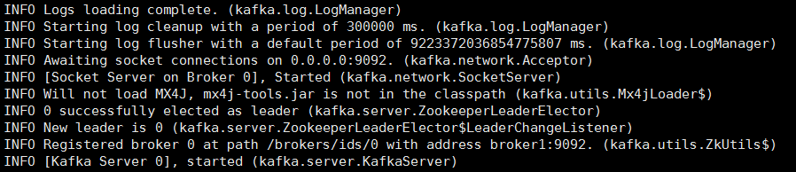
7-2. Launching Kafka brokers
When it successfully works, each broker containers will show messages like the below

Slide 31
8. Make a topic
Create topic
$ bin/kafka-topics.sh --create --zookeeper localhost:2181 --replication-factor 1 --partitions 3 --topic resource
We can check topics.
Topic List
$ bin/kafka-topics.sh --list --zookeeper localhost:2181
Topic specification
$ bin/kafka-topics.sh --describe --zookeeper localhost:2181 --topic resource

Slide 32
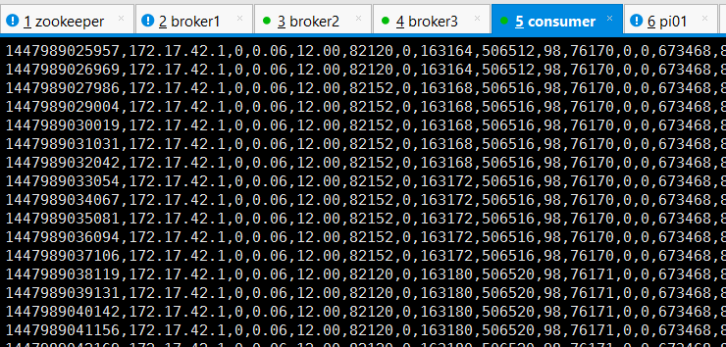
9. Consume message from brokers
Launch consumer script on the Consumer container
$ bin/kafka-console-consumer.sh --zookeeper localhost:2181 --topic resource --from-beginning

Slide 33
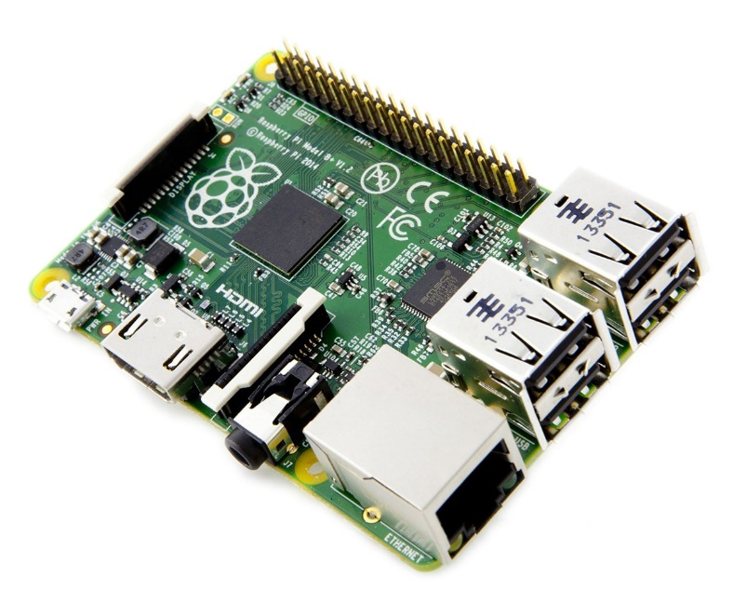
Connecting Configuration on Raspberry Pi

Slide 34
In this section
You
Kafka broker cluster
Hypriot OS
Hypriot OS
Ubuntu Linux
Raspberry Pi
NUC
Notes:
IoT-FastData-Cloud에 기반한 Container 대응 SmartX-mini

Slide 35
1. Download Source from Github
Git package is already installed in Hypriot OS
Download all files from Github
(http://github.com/SmartXBox/SmartX-mini)
$ git clone https://github.com/SmartXBox/SmartX-mini.git
Folder List
In this section, we use this

Slide 36
2. Install Net-SNMP
Update packages
$ sudo apt-get update
Download Net-SNMP
$ apt-get install –y snmp snmpd snmp-mibs-downloader
Download MIBs
$ sudo download-mibs
Modify configuration file
$ sudo vi /etc/snmp/snmpd.conf
#rocommunity public localhost -> Delete #
$ sudo systemctl restart snmpd.service

Slide 37
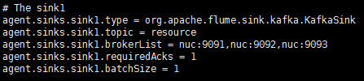
3. Install Flume on RPi
Build Dockerfile ※ It takes long time.
$ cd SmartX-mini/raspbian-flume
$ docker build --tag raspbian-flume .
$ docker run -it --net=host --name flume raspbian-flume
2) Check the configuration file
$ vi conf/flume-conf.properties
3) Modifying broker list
Default value sets “nuc”
Edit them into your own nuc’s hostname

Slide 38
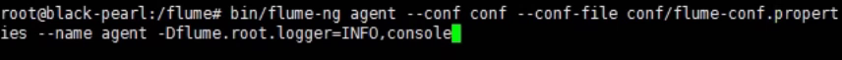
4. Run Flume Agent
Run Flume on RPi
$ bin/flume-ng agent --conf conf --conf-file conf/flume-conf.properties --name agent -Dflume.root.logger=INFO,console

Slide 39
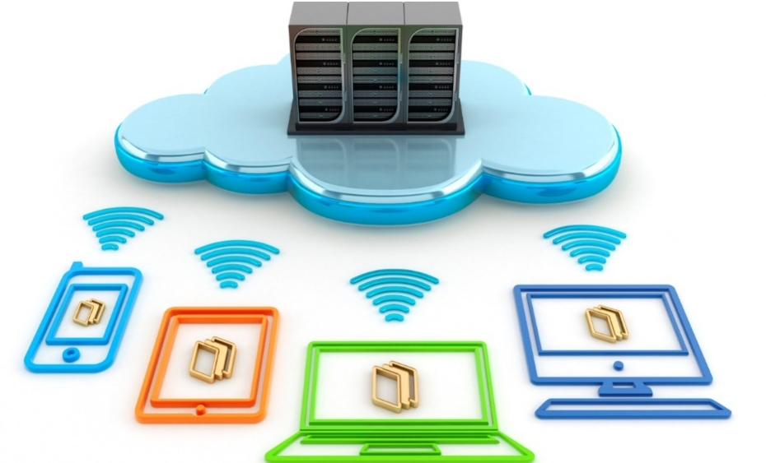
Thank You for
Your Attention
Any Questions?

Slide 40
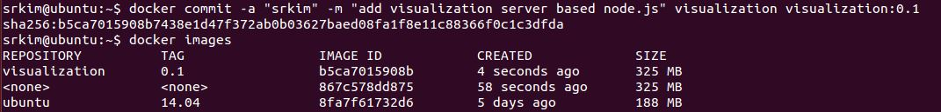
(참고) Container 변경사항 저장 및 재시작
Commit Container
컨테이너 내의 변경사항을 반영하여 새로운 컨테이너 이미지 작성
Ctrl+P+Q
docker commit -a “[username]” -m "add visualization server based node.js" visualization visualization:0.1
Restart Container
Stop했던 컨테이너를 Restart하면 이전 작업 내용을 유지한 채로 다시 컨테이너를 시작할 수 있다.
docker stop visualization
docker restart visualization

